Slide 1

Application Delivery Fundamentals :
Lua Proramming

Slide 2
Lua Regex
Pattern | Meaning
. | (dot) matches any character
%a | letters (a-z, A-Z)
%d | digits (0-9)
%s | whitespace
%w | alphanumeric
+ | one or more repetitions
* | zero or more repetitions
- | zero or more (non-greedy)
^ | beginning of string
$ | end of string
[] | set of characters
[^] | negated set

Slide 3
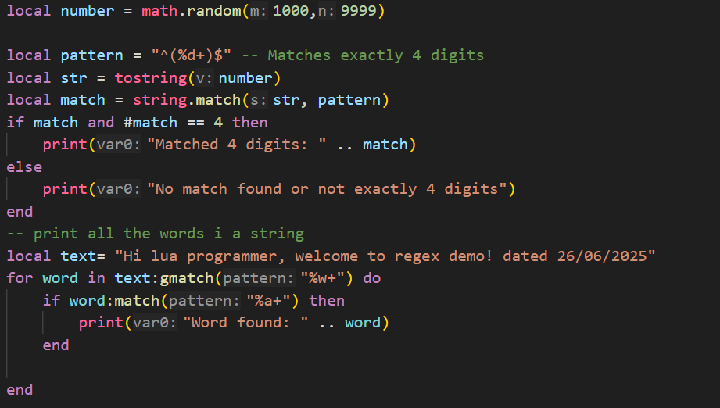
Lua Regex

Slide 4
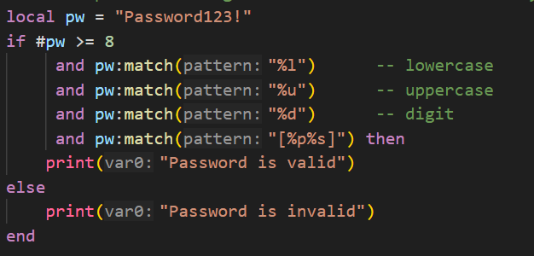
Lua Regex
-- check password using lua has at least 8 characters, one uppercase letter, one lowercase letter, one number, and one special character

Slide 5
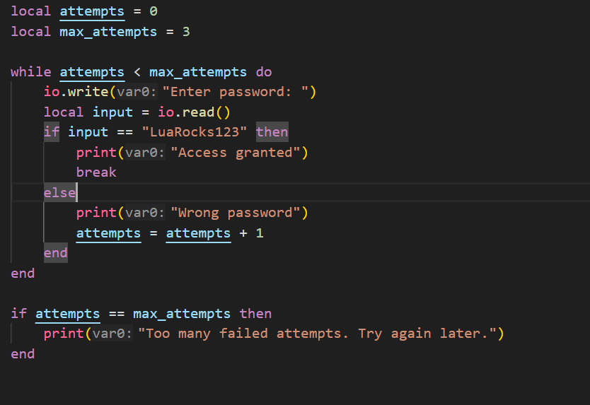
Loops

Slide 6
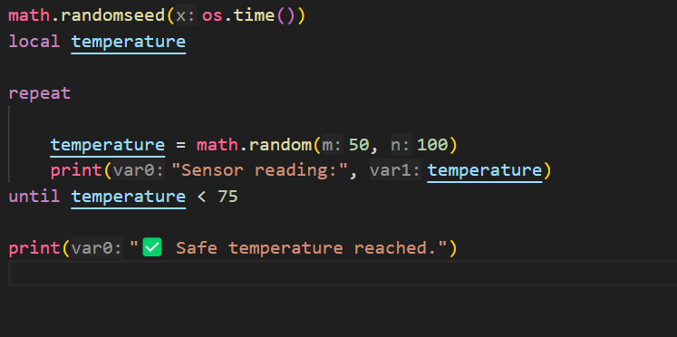
Loops

Slide 7
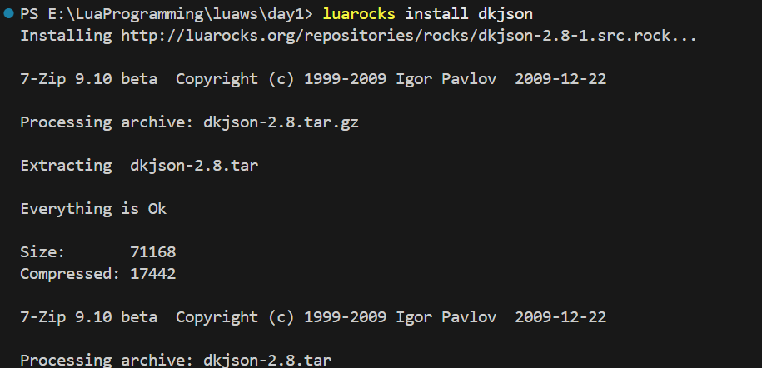
External Libraries
Json Parsing

Slide 8
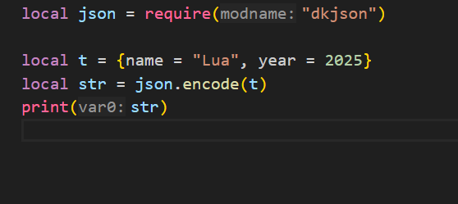
External Libraries
Json Parsing

Slide 9
Tables
Lua tables are the only data structure in the language — they serve as:
Arrays
Dictionaries (maps)
Objects
Records
Sets
Modules

Slide 10
Table Constructor
Empty table
local t = {}
Array-style constructor (numerical indices)
local colors = { "red", "green", "blue" }
-- Equivalent to:
-- colors = { [1] = "red", [2] = "green", [3] = "blue" }

Slide 11
Table Constructor
Key-value constructor (dictionary)
local person = {
name = "Alice",
age = 28,
city = "Delhi"
}
-- Internally: { ["name"] = "Alice", ["age"] = 28, ... }

Slide 12
Table Constructor
Mixed constructor
local mix = {
"cat",
species = "feline",
[10] = "ten",
[true] = "boolean key"
}

Slide 13
Table Indices
Valid Lua table keys (indices):
Any value except nil and NaN
Common: number, string, boolean, even table and function

Slide 14
Important Index Rules
Keys must not be nil or NaN:
local t = {}
t[nil] = "X" -- ❌ Error
t[0/0] = "Y" -- ❌ NaN: invalid
You can overwrite values with same keys:
local t = { a = 1, a = 2 } -- Final value: a = 2

Slide 15
Tables
-- Empty table
local t = {}
-- With values
local t2 = { "apple", "banana", "cherry" }
-- Key-value table (like a dictionary)
local t3 = {
name = "Alice",
age = 30,
city = "Chennai"
}

Slide 16
Tables Iteration
For array-style:
for i, v in ipairs(fruits) do
print(i, v)
end

Slide 17
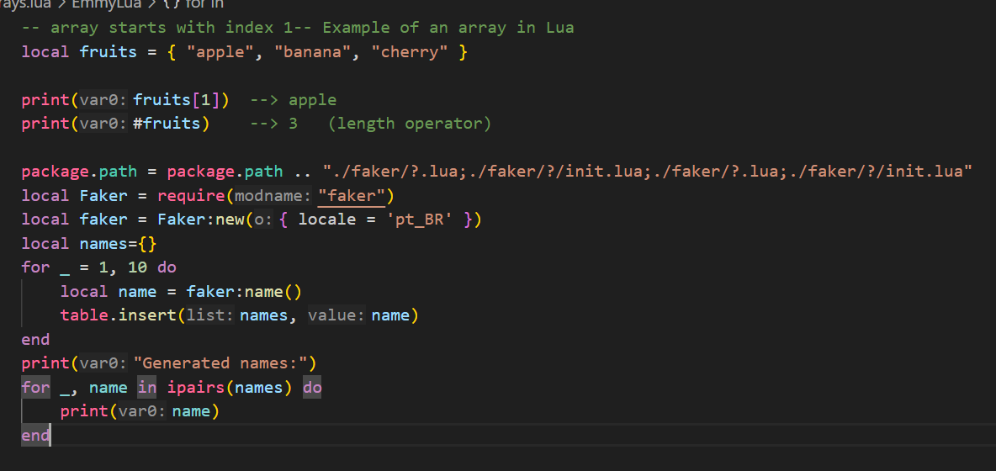
Tables as Arrays
Lua arrays start at index 1 (not 0):

Slide 18
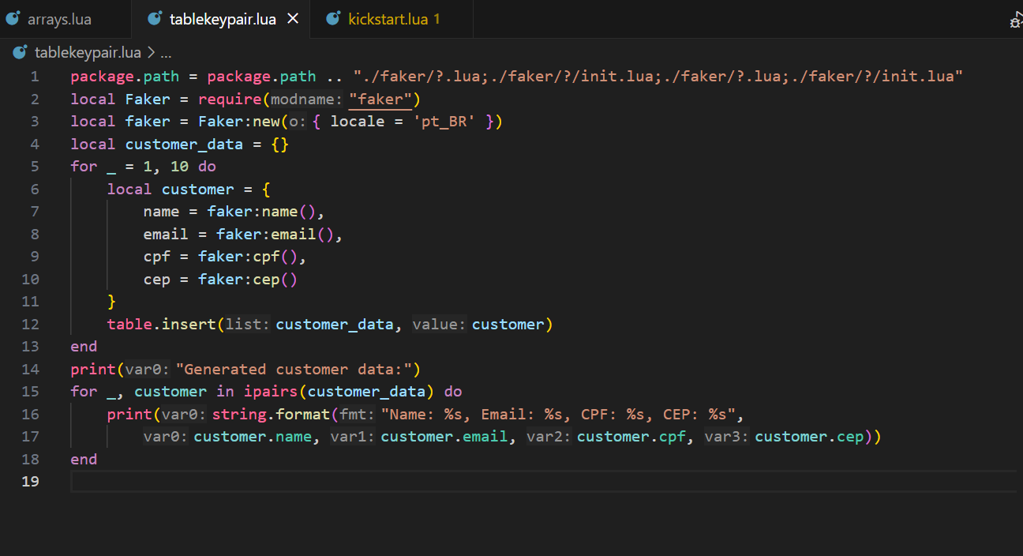
Table as Dictionary

Slide 19
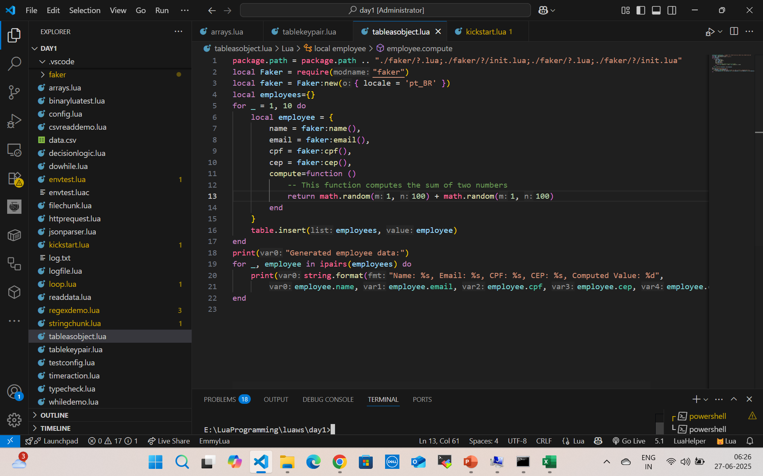

Tables as Objects (with functions)

Slide 20
MetaTable
A metatable is a table that defines how another table behaves in special situations, like:
Adding two tables
Accessing a missing field
Making a table callable like a function
Used to add behavior like operator overloading, default values, or OO-like features.

Slide 21
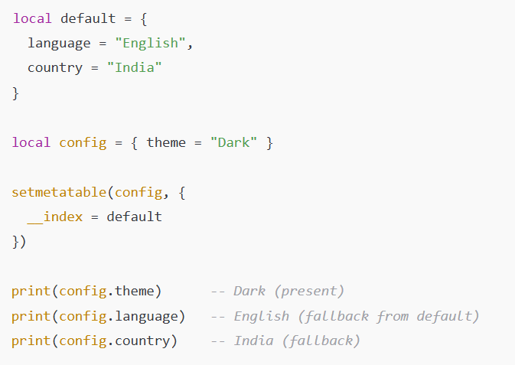
Meta tables Missing Index
__index as a table (default values) – Missing Index

Slide 22

Meta tables addition
function newMatrix(a, b)
local mat = { a = a, b = b }
local mt = {
__add = function(m1, m2)
return newMatrix(m1.a + m2.a, m1.b + m2.b)
end
}
return setmetatable(mat, mt)
end
local m1 = newMatrix(10, 20)
local m2 = newMatrix(1, 2)
local m3 = m1 + m2
print(m3.a, m3.b) --> 11 22

Slide 23
Extend to Other Operators
Metamethod | Operator
__add | +
__sub | -
__mul | *
__div | /
__mod | %
__pow | ^
__unm | Unary -

Slide 24
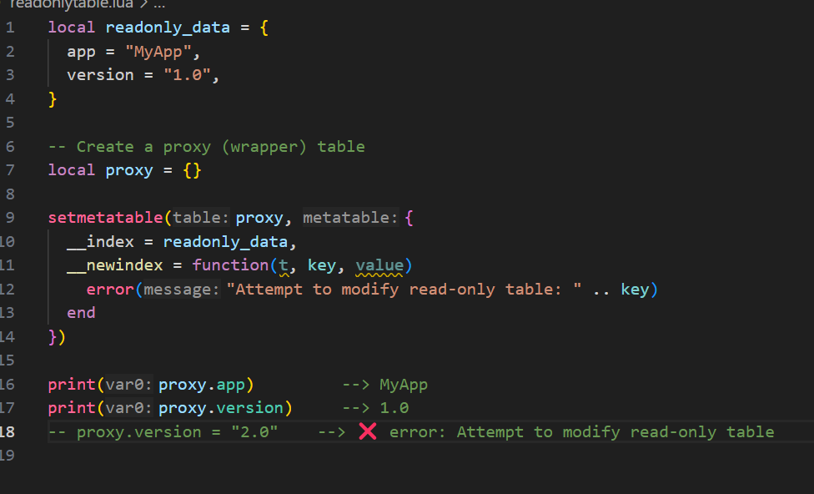
Read-only table (__newindex)

Slide 25
What is a Sequence in Lua?
A sequence is a table with positive integer keys starting from 1, with no gaps (i.e., t[1], t[2], ..., t[n], where n = #t).

Slide 26
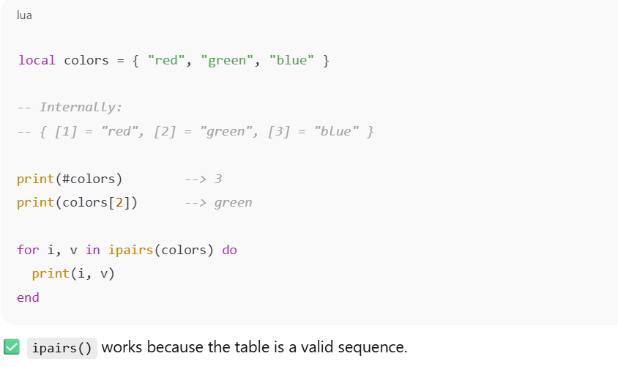

What is a Sequence in Lua?

Slide 27
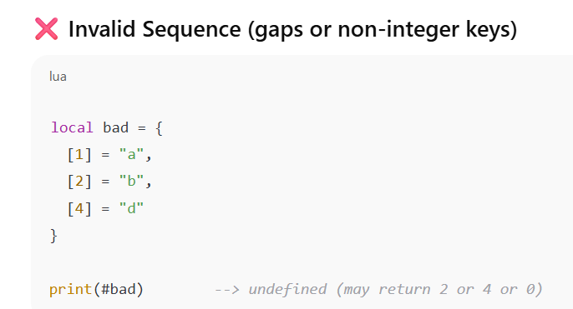
What is a Sequence in Lua?
#bad and ipairs(bad) stop at the first nil, so they're unreliable for non-continuous integer keys.

Slide 28
Useful Functions for Sequences (from table module)
Function | Purpose
#t | Length of sequence (consecutive keys)
ipairs(t) | Iterates over sequence safely
table.insert(t, v) | Adds v at end
table.remove(t, i) | Removes index i, shifts others
table.concat(t, sep) | Joins all values as string
table.sort(t) | Sorts values in-place

Slide 29
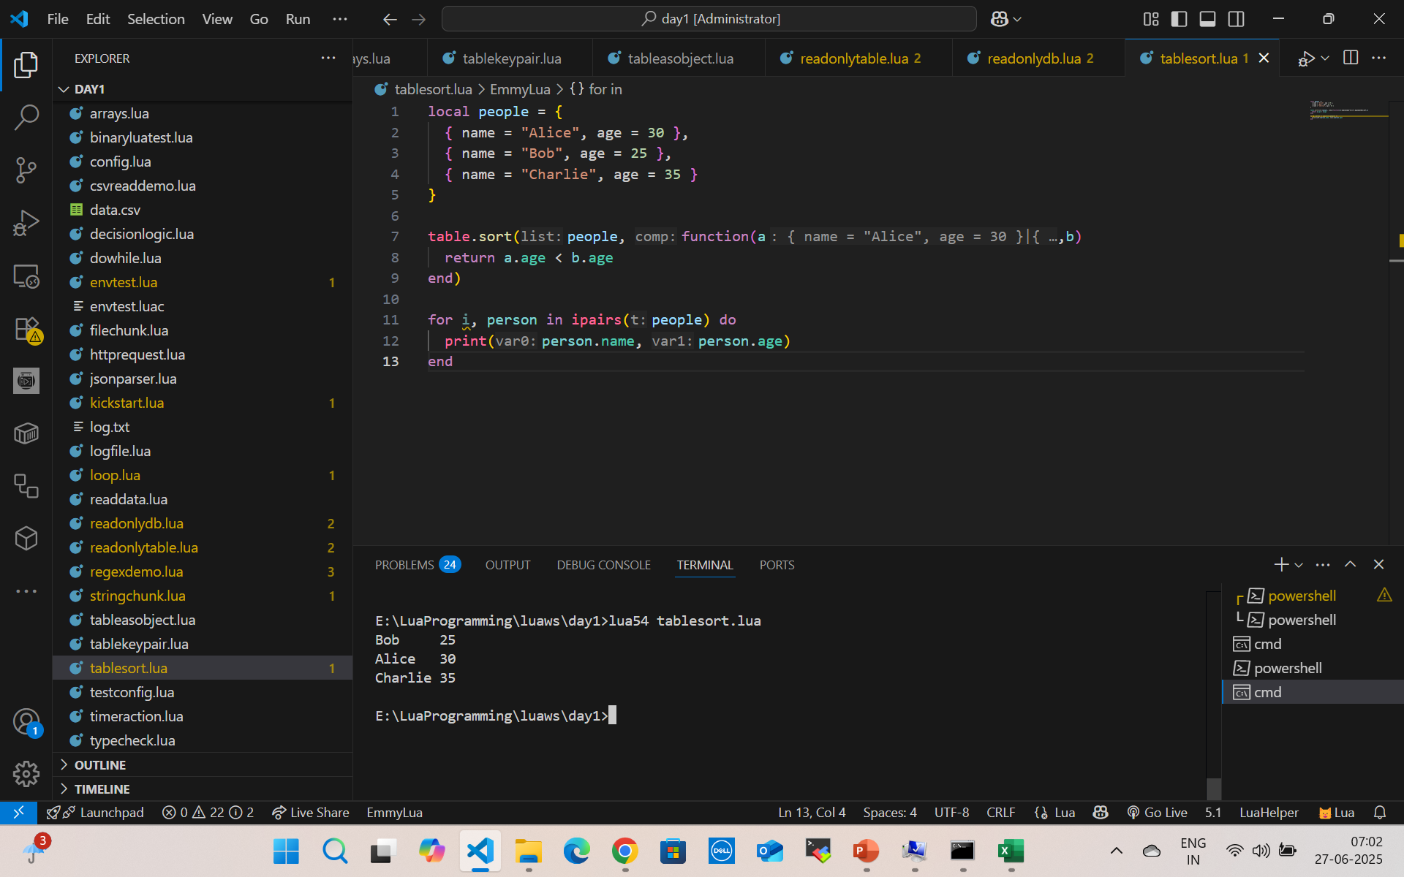
Table Sort

Slide 30
Table Sort
local names = { "Charlie", "Alice", "Bob" }
table.sort(names)
-- Output: Alice, Bob, Charlie

Slide 31
Table concat
local fruits = { "apple", "banana", "cherry" }
local result = table.concat(fruits, ", ")
print(result)
-- Output: apple, banana, cherry

Slide 32
What Is Safe Navigation?
Safe navigation means accessing nested fields without errors, even if intermediate tables or keys are nil.

Slide 33
Functions
In Lua, functions are first-class values, meaning you can:
Assign them to variables
Pass them as arguments
Return them from other functions

Slide 34
Types of functions
Function Basics
Function with Parameters
Function with Return Values
Anonymous Functions (Lambdas)
Multiple Return Values
Variadic Functions (...)
Recursive Functions
Local vs Global Functions
Functions as Table Fields (Methods)

Slide 35
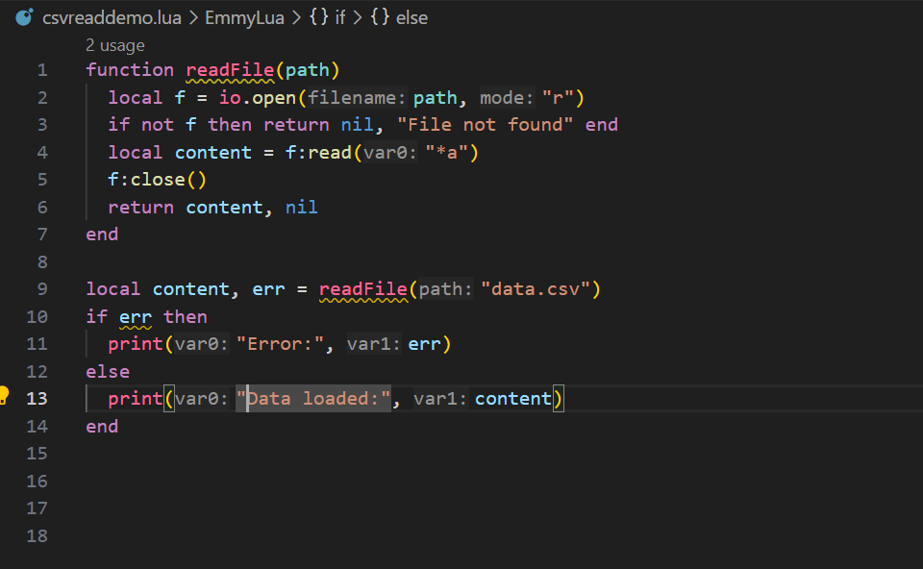
Multiple Return

Slide 36
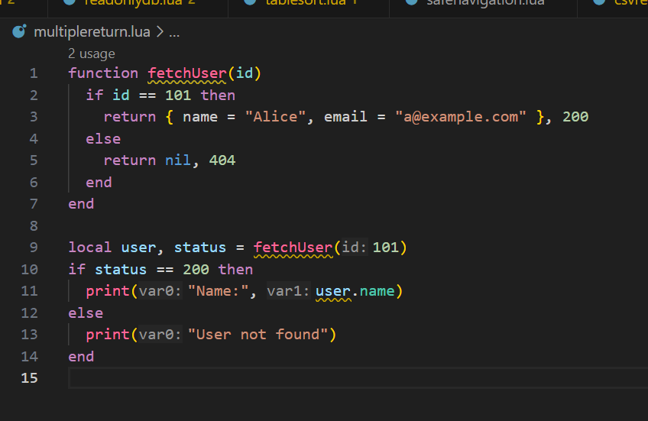
Multiple Return

Slide 37
Variadic Function
function formatCSV(...)
return table.concat({...}, ",")
end
print(formatCSV("apple", "banana", "cherry")) -- apple,banana,cherry

Slide 38
Variadic Function
function log(...)
local args = {...}
print("[LOG]", table.concat(args, " "))
end
log("User", "logged", "in", "at", os.date())

Slide 39
Table.unpack
Returns all values from a table as separate arguments (like JS ...arr or Python *args).
table.unpack(t [, i [, j]])
t: The table (usually a sequence)
i: Starting index (default 1)
j: Ending index (default #t)

Slide 40
Table.unpack
local args = { "a", "b", "c" }
print(table.unpack(args)) -- Output: a b c
function logAll(...)
local args = { ... }
print(table.unpack(args))
end
logAll("x", "y", "z") --> x y z

Slide 41
Proper Tail Calls (PTC)
What is a Tail Call?
A tail call is when a function returns the result of another function directly.

Slide 42
Real Example: Recursive Tail Call
function countdown(n)
if n == 0 then
print("Done!")
return
else
print(n)
return countdown(n - 1) -- Tail call
end
end
countdown(5)

Slide 43
Real Example: Recursive Tail Call
function route(path)
if path == "/home" then return show_home()
if path == "/login" then return show_login()
return show_404()
end
function show_home()
print("🏠 Home Page")
return route("/login") -- Tail call
end
function show_login()
print("🔐 Login Page")
end
route("/home")

Slide 44
Simple I/O Model (Interactive Console)
-- Simple Input
io.write("Enter your name: ")
local name = io.read()
print("Hello, " .. name .. "!")

Slide 45
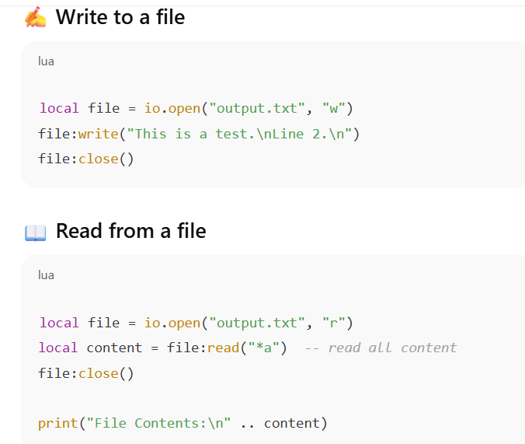
Simple File Read/Write

Slide 46
Summary Table
Operation | Function | Notes
Read input | io.read() | from keyboard
Write output | io.write() | no newline
Print line | print() | newline included
Open file | io.open(filename, mode) | "r", "w", "a" modes
Read from file | file:read("*l") or "*a" | line or all
Write to file | file:write("text") | writes as string
Close file | file:close() | must close after write

Slide 47
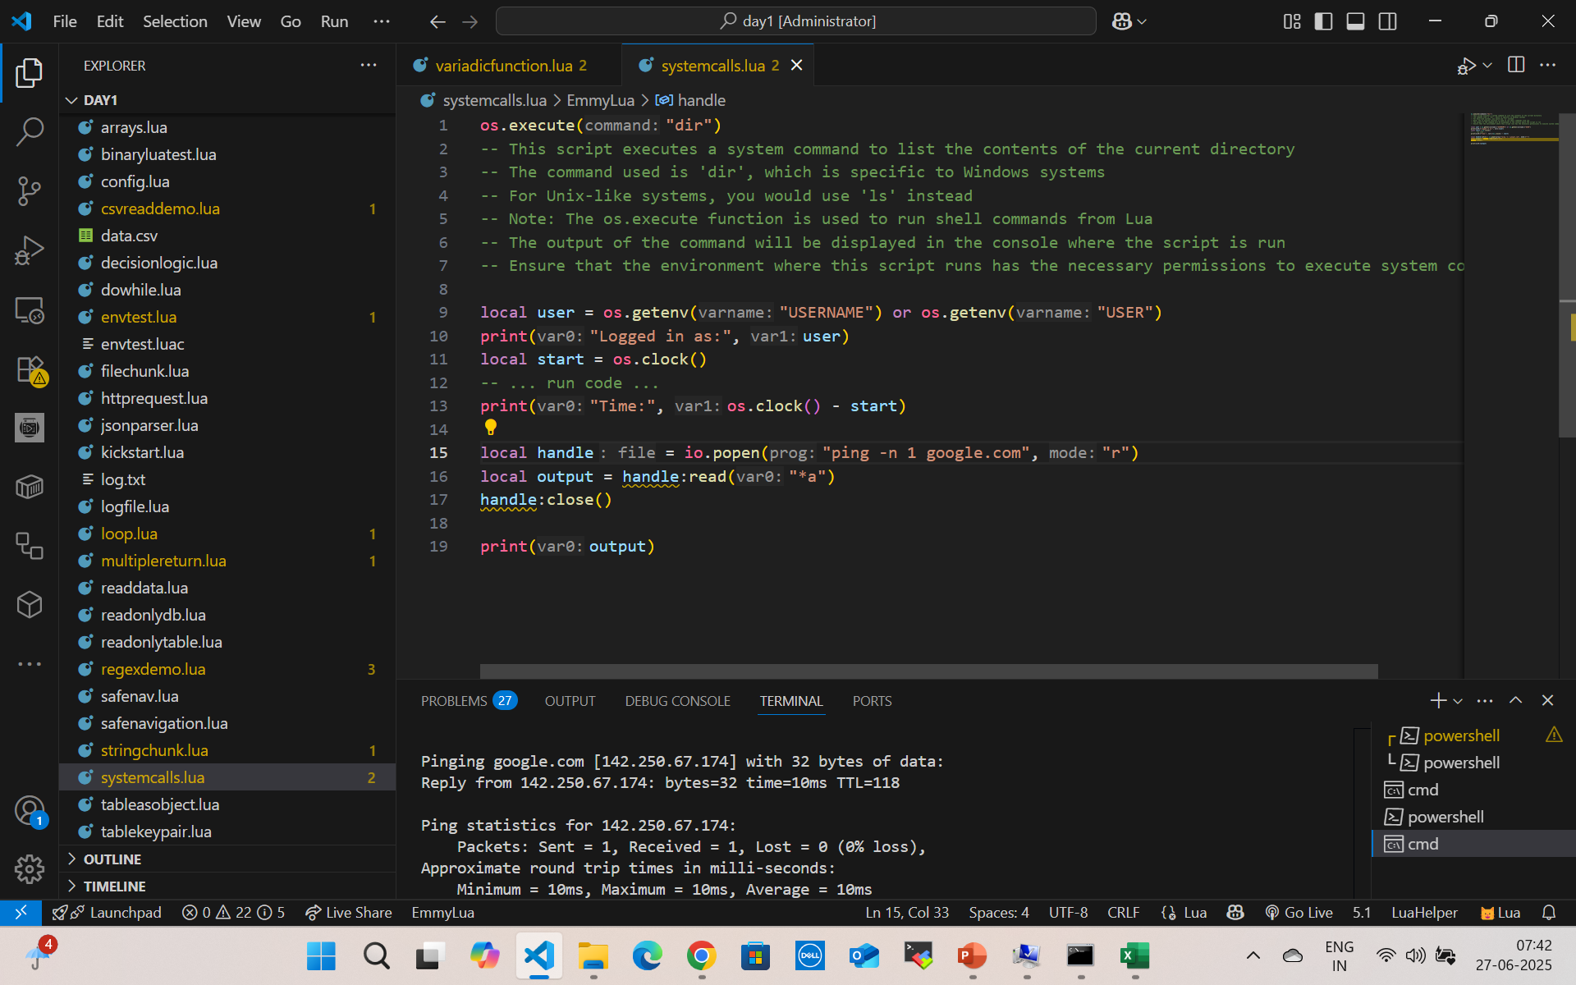
System Calls

Slide 48
Questions

Slide 49
Module Summary
Lua Getting Started
Numbers
Strings

